Slide 1
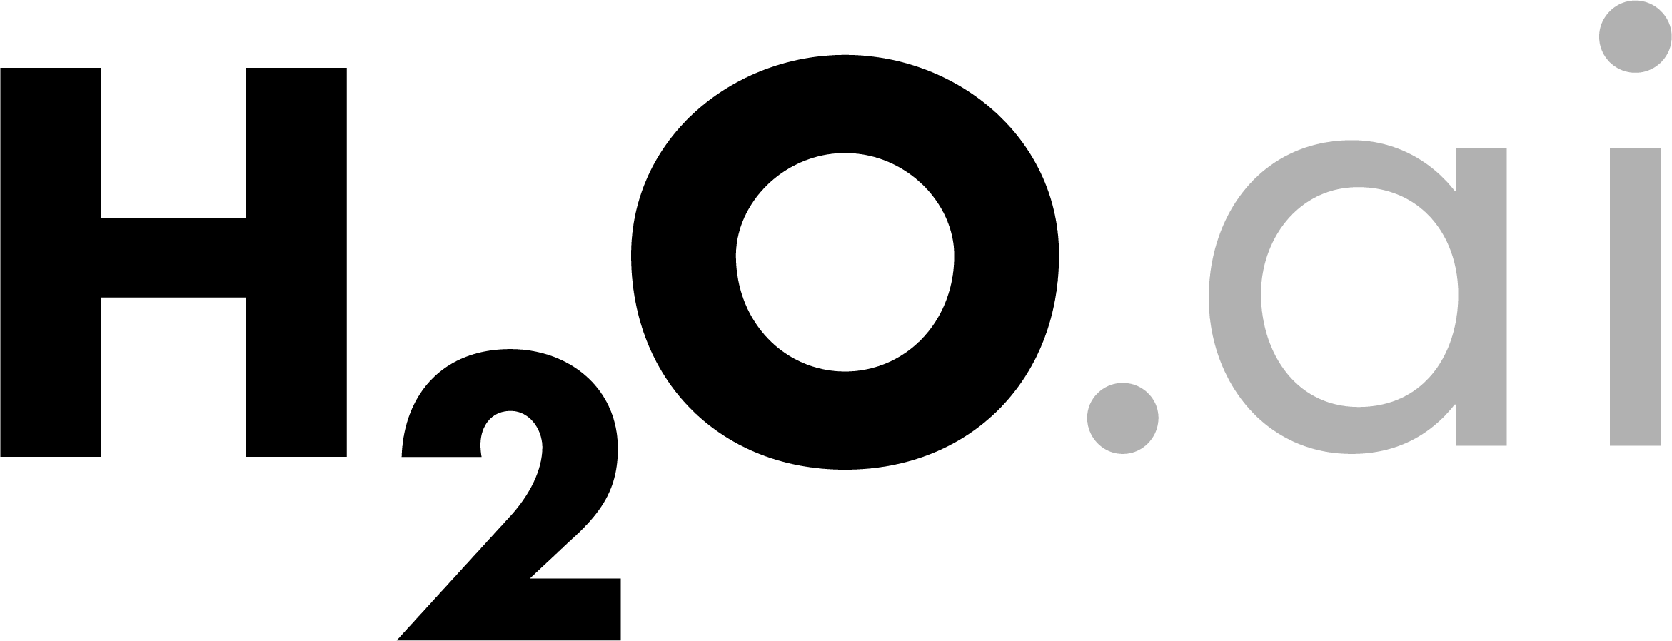
Machine Learning for
Smarter Applications
Tom Kraljevic
January 28, 2015
Jacksonville, FL

Slide 2
Outline for today’s talk
About H2O.ai and H2O (10 minutes)
H2O in Big Data Environments (10 minutes)
How H2O Processes Data (10 minutes)
Building Smarter Apps with H2O (20 minutes)
(Demo) Storm App w/ Streaming Predictions (10 minutes)
Q & A (20 minutes)
Content for today’s talk can be found at:
https://github.com/h2oai/h2o-meetups/tree/master/2015_01_28_MLForSmarterApps
H₂O.ai Machine Intelligence

Slide 3
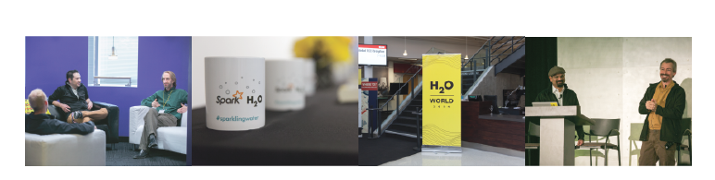
H2O.ai Overview
Founded: 2011 venture-backed, debuted in 2012
Product: H2O open source in-memory prediction engine
Team: 30
HQ: Mountain View, CA
SriSatish Ambati – CEO & Co-founder (Founder Platfora, DataStax; Azul)
Cliff Click – CTO & Co-founder (Creator Hotspot, Azul, Sun, Motorola, HP)
Tom Kraljevic – VP of Engineering (CTO & Founder Luminix, Azul, Chromatic)
H₂O.ai Machine Intelligence

Slide 4
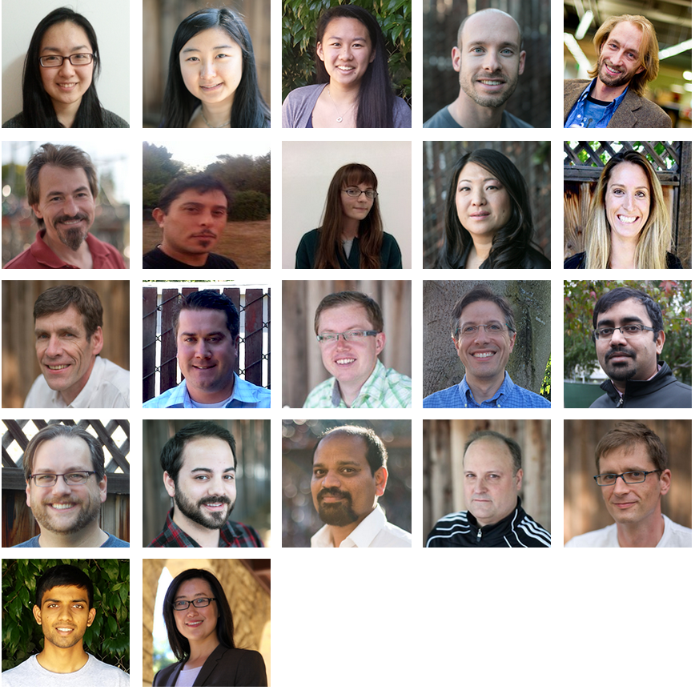
Distributed
Systems Engineers
Making ML Scale!
TBD. Customer Support
TBD
Head of Sales
H₂O.ai Machine Intelligence

Slide 5

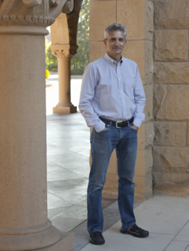
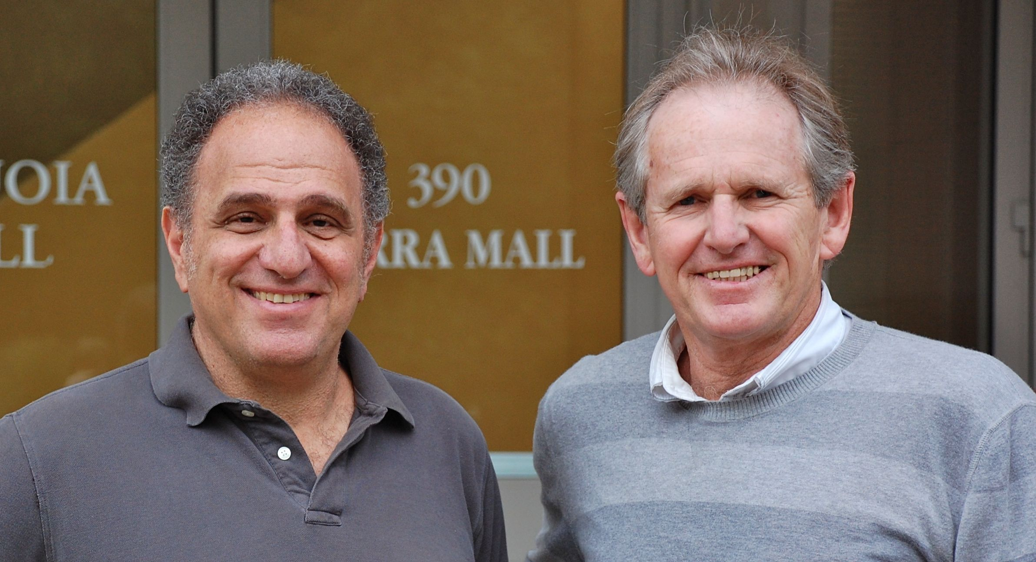
cientific Advisory Council
Stephen Boyd
Professor of EE Engineering
Stanford University
Rob Tibshirani
Professor of Health Research
and Policy, and Statistics
Stanford University
Trevor Hastie
Professor of Statistics
Stanford University
H₂O.ai Machine Intelligence

Slide 6
What is H2O?
Math Platform
Open source in-memory prediction engine
Parallelized and distributed algorithms making the most use out of multithreaded systems
API
Easy to use and adopt
Written in Java – perfect for Java Programmers
Big Data
More data? Or better models? BOTH
Use all of your data – model without down sampling
GLM, Random Forest, GBM, PCA, etc.
REST API (JSON) – drives H2O from R, Python, Excel, Tableau
Run a simple GLM or a more complex GBM to find the best fit for the data
More Data + Better Models = Better Predictions
H₂O.ai Machine Intelligence

Slide 7
Algorithms on H2O
Supervised Learning
Generalized Linear Models: Binomial, Gaussian, Gamma, Poisson and Tweedie
Cox Proportional Hazards Models
Naïve Bayes
Statistical Analysis
Ensembles
Distributed Random Forest: Classification or regression models
Gradient Boosting Machine: Produces an ensemble of decision trees with increasing refined approximations
Deep Neural Networks
Deep learning: Create multi-layer feed forward neural networks starting with an input layer followed by multiple layers of nonlinear transformations
H₂O.ai Machine Intelligence

Slide 8
Algorithms on H2O
Unsupervised Learning
K-means: Partitions observations into k clusters/groups of the same spatial size
Clustering
Dimensionality Reduction
Principal Component Analysis: Linearly transforms correlated variables to independent components
Anomaly Detection
Autoencoders: Find outliers using a nonlinear dimensionality reduction using deep learning
H₂O.ai Machine Intelligence

Slide 9
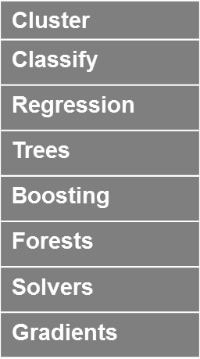
Python
R
Tableau
JSON
Java
Scala
Excel
H₂O Prediction Engine
On Premise
On Hadoop & Spark
On EC2
SDK / API
Rapids Query R-engine
Nano Fast Scoring Engine
In-Mem Map Reduce
Distributed fork/join
Deep Learning
Per Node
2M Row ingest/sec
50M Row Regression/sec
750M Row Aggregates / sec
Memory Manager Columnar Compression
Ensembles
H₂O.ai Machine Intelligence
HDFS
S3
SQL
NoSQL

Slide 10
H2O in Big Data Environments

Slide 11
H2O on YARN Deployment
Hadoop Gateway Node
Hadoop Cluster
hadoop jar h2odriver.jar …
YARN RM
YARN Worker Nodes
YARN Node
Managers (NM)
NM
NM
NM
NM
NM
NM
H2O Mappers
(YARN Containers)
H₂O
H₂O
H₂O
HDFS
Data Nodes
HDFS

Slide 12
Now You Have an H2O Cluster
Hadoop Gateway Node
Hadoop Cluster
hadoop jar h2odriver.jar …
YARN RM
YARN Worker Nodes
YARN Node
Managers (NM)
NM
NM
NM
H2O Mappers
(YARN Containers)
H₂O
H₂O
H₂O
HDFS
Data Nodes
HDFS

Slide 13
Read Data from HDFS Once
Hadoop Gateway Node
Hadoop Cluster
hadoop jar h2odriver.jar …
YARN RM
YARN Worker Nodes
YARN Node
Managers (NM)
NM
NM
NM
H2O Mappers
(YARN Containers)
H₂O
H₂O
H₂O
HDFS
Data Nodes
HDFS

Slide 14
Build Models in-Memory
Hadoop Gateway Node
Hadoop Cluster
hadoop jar h2odriver.jar …
YARN RM
YARN Worker Nodes
YARN Node
Managers (NM)
NM
NM
NM
H2O Mappers
(YARN Containers)
H₂O
H₂O
H₂O
Notes:
H2O MapReduce is not Hadoop MapReduce
For more details, go visit cliff in his Hacker corner.

Slide 15
How H2O Processes Data

Slide 16
Distributed Data Taxonomy
Vector
H₂O.ai Machine Intelligence

Slide 17
Distributed Data Taxonomy
Vector
The vector may be very large
(billions of rows)
Stored as a compressed column (often 4x)
Access as Java primitives with
on-the-fly decompression
Support fast Random access
Modifiable with Java memory semantics
H₂O.ai Machine Intelligence

Slide 18
Distributed Data Taxonomy
Vector
Large vectors must be distributed over multiple JVMs
Vector is split into chunks
Chunk is a unit of parallel access
Each chunk ~ 1000 elements
Per-chunk compression
Homed to a single node
Can be spilled to disk
GC very cheap
H₂O.ai Machine Intelligence

Slide 19
Distributed Data Taxonomy
Distributed data frame
age
gender
zip_code
ID
A row of data is always stored in a single JVM
Similar to R data frame
Adding and removing columns is cheap
H₂O.ai Machine Intelligence

Slide 20
Distributed Fork/Join
Task is distributed in a tree pattern
JVM
task
Results are reduced at each inner node
Returns with a single result when all subtasks done
JVM
JVM
task
task
JVM
JVM
task
task
H₂O.ai Machine Intelligence

Slide 21
Distributed Fork/Join
JVM
JVM
task
task
task
task
chunk
task
task
chunk
chunk
On each node the task is parallelized using Fork/Join
H₂O.ai Machine Intelligence

Slide 22
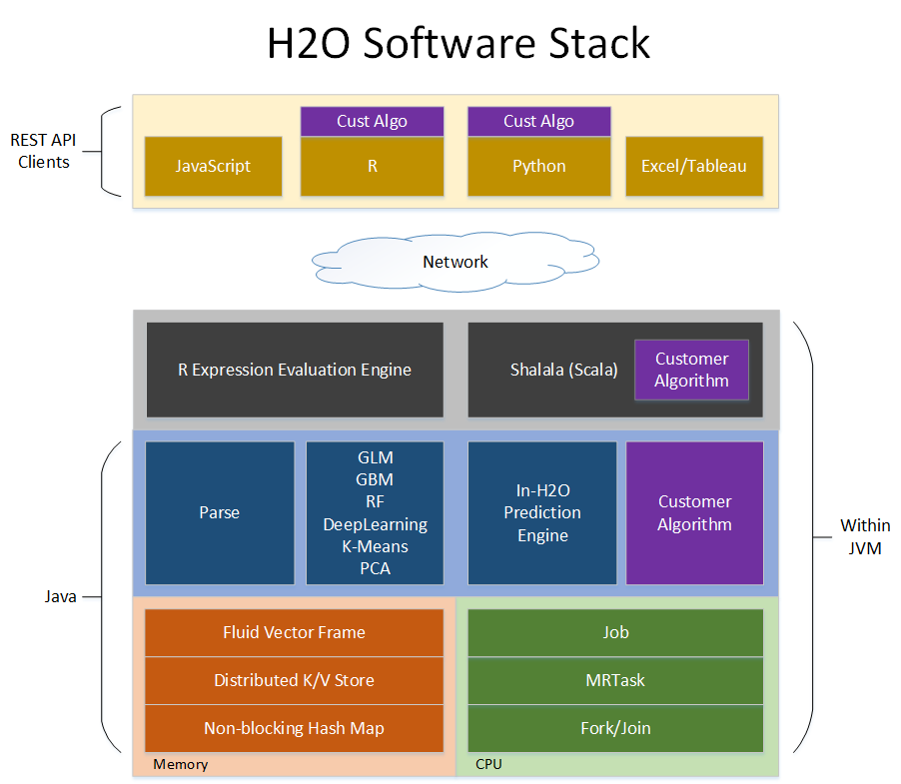

Slide 23
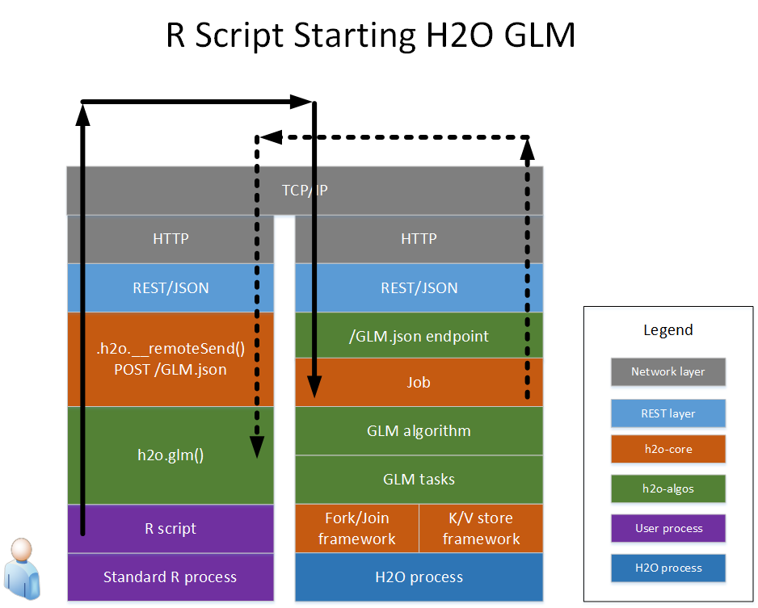

Slide 24

Propensity to Buy modeling factory

Slide 25
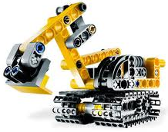
What is a Propensity To Buy model?
A Propensity To Buy model (P2B) is a statistical model that tries to predict whether a certain company will buy a certain product in a given time frame in the future.
Historical
Firmographics
Past Purchase Behavior
Contacts (# and types)
Marketing Interactions
Cust Sat surveys
Macroeconomic indicators
Purchase / Non Purchase
Build Statistical
Model
SCORE: probability that a company will buy a specific technology in the next quarter
VALUE: bookings amount that Cisco will likely see IF the company in fact buys the technology
Latest
Firmographics
Past Purchase Behavior
Contacts (# and types)
Marketing Interactions
Customer satis. surveys
Macroeconomic indicators
predicted purchase window
Timing for Scoring
past purchase behavior
and marketing interactions
firmographics
and contact data
…
…
Q4
Q1
Q2
Q3
Q4
(most recent closed quarter)
Q1
Q2
t
Scoring happens
here
H₂O.ai Machine Intelligence

Slide 26
H2O Business Benefit with P2B
Before, without H2O
Without H2O:
Models needed to be prepared in advance, not to delay scoring
More time preparing models, less time left for using the scores in the sales activities
With H2O:
Newer buying patterns incorporated immediately into models
Scores are published sooner
More time for planning and executing activities
Data
Refresh Q1
Data
Refresh Q2
P2B Training
Prepare, execute
Mktg & Sales activities
models
Scoring
Q1
Q2
Now, with H2O
Data
Refresh
Data
Refresh
Train
& score
Train
& score
Prepare, execute
Mktg & Sales
activities
Prepare, execute
Mktg & Sales
activities
Q1
Q2
H₂O.ai Machine Intelligence

Slide 27
Results & Lessons Learned
Improvements
P2B factory is 15x faster with H2O
Quicker techniques for simpler problems, deeper for harder ones (grid searches!)
Ensembles improved accuracy and stability of models significantly
Lessons Learned
Even with few nodes speed improvement over traditional data mining tools is substantial
H2O becomes really powerful and robust when combined with R
Rely on H2O’s extremely responsive support
H₂O.ai Machine Intelligence

Slide 28

Fraud prevention using Deep Learning

Slide 29
Fraud Prevention at PayPal
Transaction Level
Employs state of the art machine learning and statistical models to flag fraudulent behavior upfront
More sophisticated algorithms after transaction complete
Account Level
Monitor activity to identify abusive behavior
Network Level
Monitor account to account interaction
Frequent transfer of money from sever accounts to one central account suspicious
Frequent payments, suspicious profile changes
H₂O.ai Machine Intelligence

Slide 30
Fraud Prevention at PayPal
Why Deep Learning?
Unearth low-level complex abstractions
Why H2O?
Highly scalable
Learn complex, highly varying functions not present in the training examples
Widely employed for image/video processing and object recognition
Superior performance
Flexible deployment
Works seamlessly with other big data frameworks
Simple interface
Experiment
Dataset
160 million records
1500 features (150 categorical)
0.6TB compressed in HDFS
Infrastructure
800 node Hadoop (CDH3) cluster
Decision
Fraud/not-fraud
H₂O.ai Machine Intelligence

Slide 31
Conclusions using H2O
Deep Learning with H2O is beneficial for payment fraud prevention
Network architecture- 6 layers with 600 neurons each performed the best
Activation function
RectifierWithDropout performed the best
Improved performance with limited feature set & a deep network
11% improvement with a third of the original feature set, 6 hidden layers, 600 neurons each
Robust to temporal variations
H₂O.ai Machine Intelligence

Slide 32
Bordeaux Wines

Slide 33
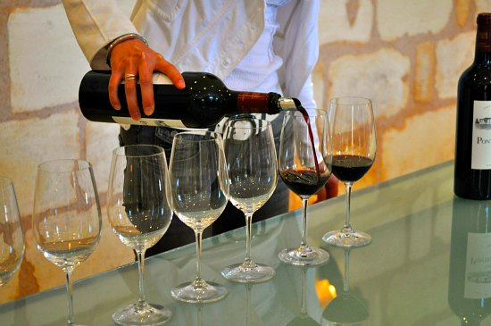

Unsupervised Learning & Bordeaux Wine
A personal and expen$$$ive obsession
Alex Tellez - h2o.ai

Slide 34
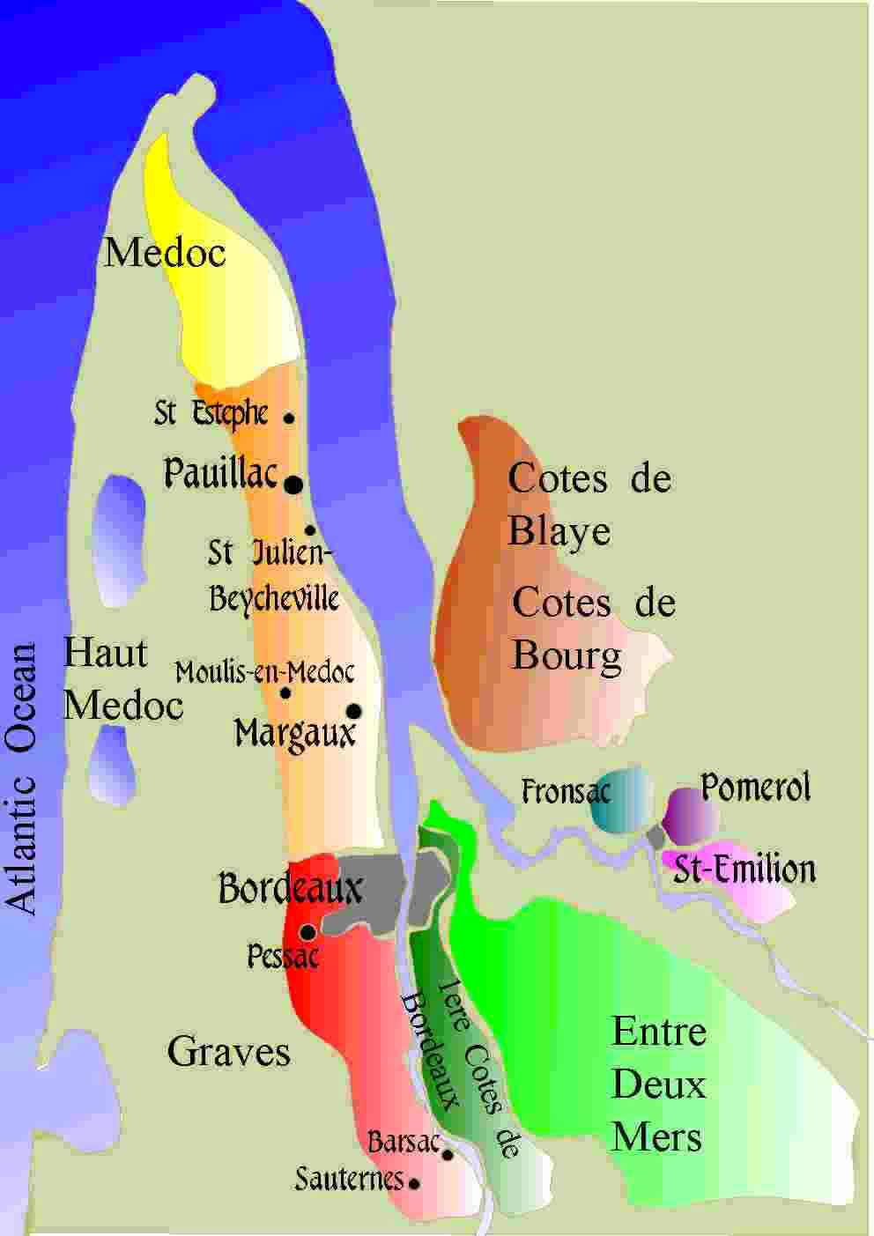
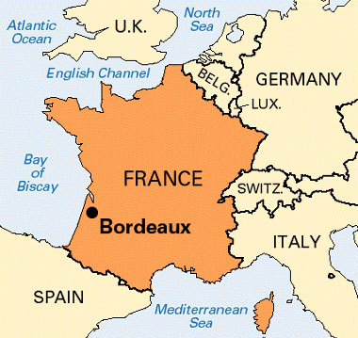
bordeaux wine
Largest wine-growing region in France
+ 700 Million bottles of wine produced / year !
Some years better than others: Great ($$$) vs. Typical ($)
Last Great years: 2010, 2009, 2005, 2000

Slide 35
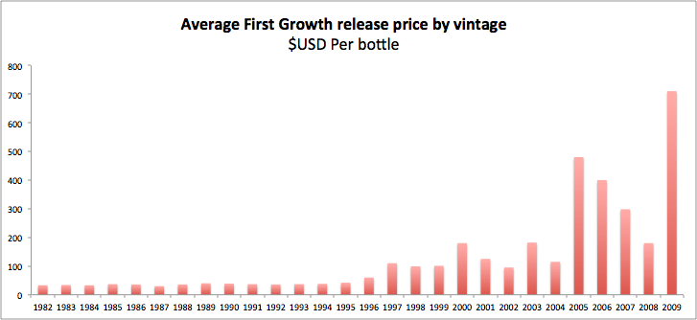
‘en primeur’
While wine is still barreled, purchasers can ‘invest’ in the wine
before bottling and official public release.
Advantage: Wines may be considerably cheaper during
‘en primeur’ period than @ bottling.
Great Years: 2009, ’05, ‘00

Slide 36
great vs. typical vintage?
Question:
Can we study weather patterns in Bordeaux
leading up to harvest to identify ‘anomalous’ weather years >>
correlates to Great ($$$) vs. Typical ($) Vintage?
The Bordeaux Dataset (1952 - 2014 Yearly)
Amount of Winter Rain (Oct > Apr of harvest year)
Average Summer Temp (Apr > Sept of harvest year)
Rain during Harvest (Aug > Sept)
Years since last Great Vintage

Slide 37
autoencoder + anomaly detection
In Steps:
1) Train deep autoencoder to learn ‘typical’ vintage weather pattern
2) Append ‘great’ vintage year weather data to original dataset
3) IF great vintage year weather data does NOT match learned
weather pattern, autoencoder will produce high reconstruction
error (MSE)
Goal:
‘en primeur of en primeur’
- Can we use weather patterns to identify anomalous years
>> indicates great vintage quality?

Slide 38
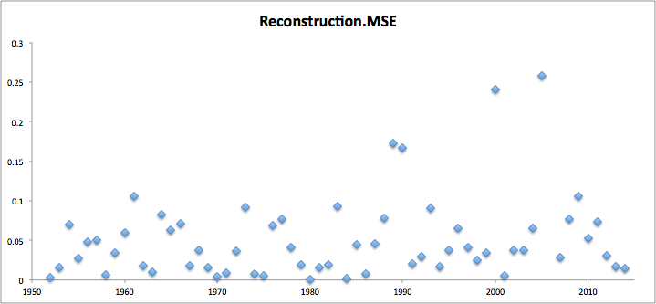
results (MSE > 0.10)
2005 V
2000 V
1989 V
Mean Square Error
1990 V
1961 V
2009 V
1982 V
2010 V

Slide 39
2014 bordeaux??
2014 ??
Mean Square Error

Slide 40
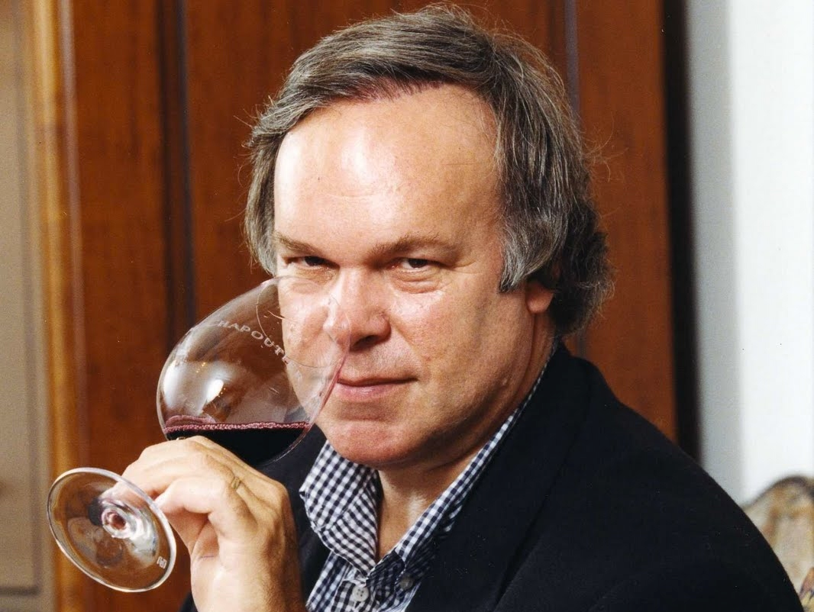
robert parker jr.
“The world’s most prized palette” - Financial Times

Slide 41
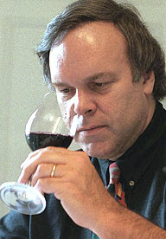
describing wines
…wet forest floor
…decaying animal skin
=
…cat pee
…grandmother’s closet
…barnyardy (AKA sh*t)
…asian plum sauce
…chewy tannins
Can we use Parker reviews to recommend wines we would like??

Slide 42
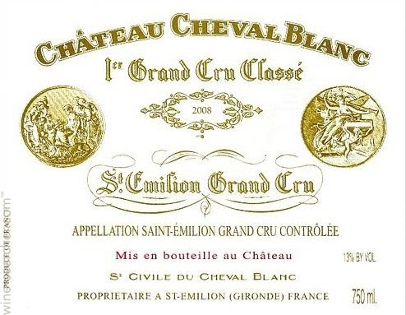
wine recommendations
I like: 2000 Cheval Blanc (Red)
Robert Parker Tasting Notes:
“…sweet nose of menthol, melted licorice, boysenberry, blueberry,
creme de cassis…sweet tannins w/ hints of coffee & earth”
So I’m at BevMo…now what?

Slide 43
approach
In Steps:
1. Collect hundreds of Robert Parker reviews of wine
2. Create bag-of-words dataset & scale word counts between 0 & 1
(~ probability a particular word occurs in a wine review)
3. Build deep autoencoder from sparse bag-of-words matrix
>> reduce to 10 ‘deep features’
4. Take Euclidian distance of wine I like (2000 Cheval Blanc) to
other wines >> Information Retrieval
5. ‘Nearby’ wine review-vectors = recommendations!

Slide 44
(hella) Deep autoencoder
Decoder
Wine
Review
125 H.F.
10
125 H.F.
250 H.F.
500 hidden features
3,000 columns
3,000 columns
500 hidden features
250 H.F.
Encoder

Slide 45
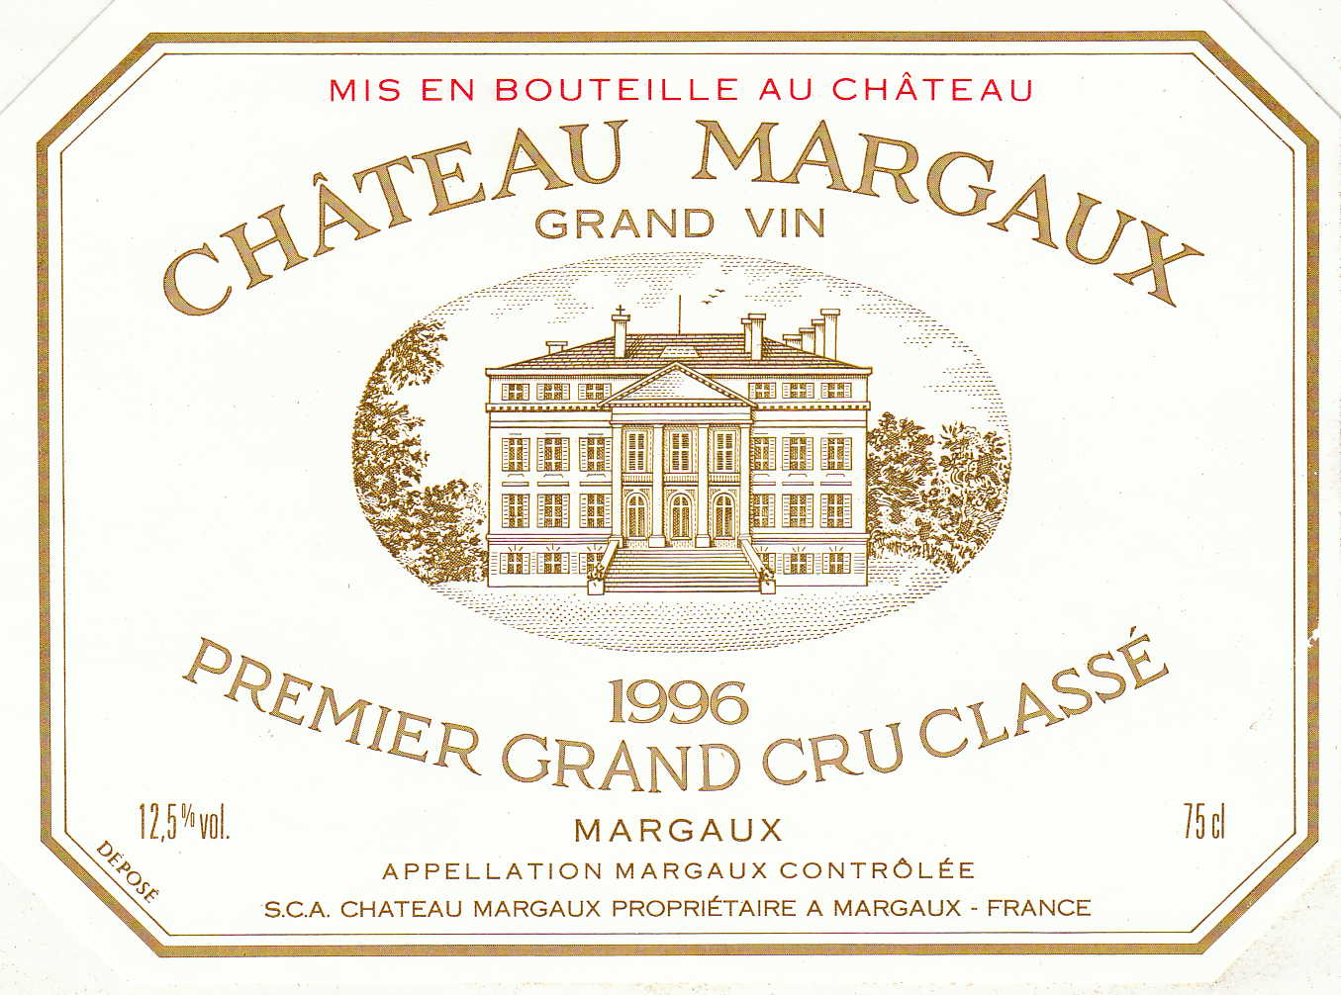



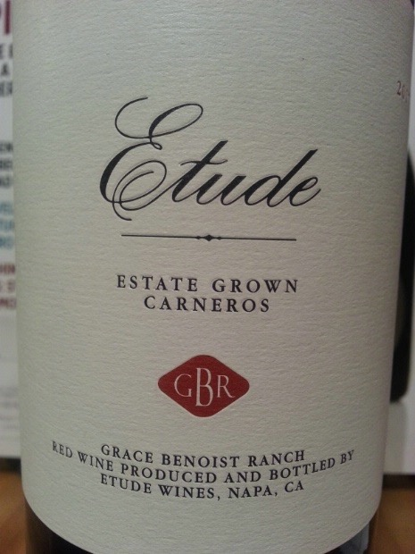

euclidian distance
Input:
10
Output
Deep Feature Space
Deep Feature Space

Slide 46
results
I like: 2000 Cheval Blanc
“…sweet nose of menthol, melted licorice, boysenberry, blueberry,
creme de cassis…sweet tannins w/ hints of coffee & earth”
Similar Wines:
“… aromas of licorice, damp forest floor, blueberries & currant”
“…loads of cassis, coffee, earth & chocolatey notes”
“…massive blackberry, mulberry fruit intermixed with
earth, crushed rocks”
“…ethereal bouquet of menthol, coffee, wet stones,
black cherries & blackberries.”

Slide 47
Real-time Streaming Predictions
with H2O and Storm

Slide 48


H₂O on Storm
Modeling workflow
Real-time Stream
H₂O
(Spout)
Emit POJO Model
Real-time data
(Bolt)
H₂O
Scoring
POJO
Data
Source
(e.g. HDFS)
Predictions
H₂O.ai Machine Intelligence

Slide 49
Q & A
Thanks for attending!
Content for today’s talk can be found at:
https://github.com/h2oai/h2o-meetups/tree/master/2015_01_28_MLForSmarterApps
H₂O.ai Machine Intelligence

